Slide 1
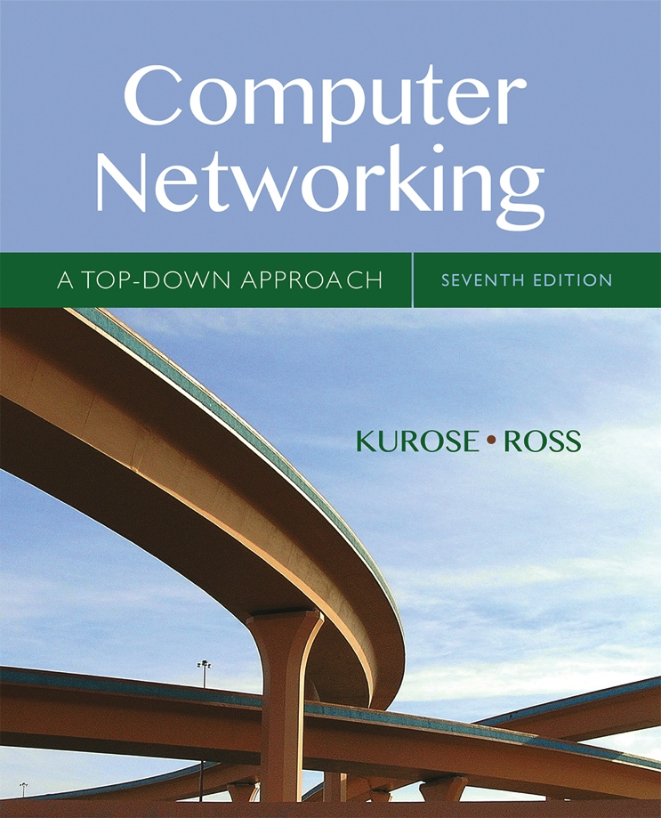
Computer Networking: A Top Down Approach
Seventh Edition
Chapter 7
Wireless and Mobile Networks
Copyright © 2017, 2013, 2010 Pearson Education, Inc. All Rights Reserved
Notes:
L03 – 11/11/2019
If this PowerPoint presentation contains mathematical equations, you may need to check that your computer has the following installed:
1) MathType Plugin
2) Math Player (free versions available)
3) NVDA Reader (free versions available)

Slide 2
Wireless and Mobile Networks
Background:
# wireless (mobile) phone subscribers now exceeds # wired phone subscribers (5-to-1)!
# wireless Internet-connected devices equals # wireline Internet-connected devices
laptops, Internet-enabled phones promise anytime untethered Internet access
two important (but different) challenges
wireless: communication over wireless link
mobility: handling the mobile user who changes point of attachment to network

Slide 3
Learning Objectives (1 of 6)
7.1 Introduction
Wireless
7.2 Wireless links, characteristics
C D M A
7.3 I E E E 802.11 wireless LANs (“Wi-Fi”)
7.4 Cellular Internet Access
architecture
standards (e.g., 3G, L T E)
Mobility
7.5 Principles: addressing and routing to mobile users
7.6 Mobile I P
7.7 Handling mobility in cellular networks
7.8 Mobility and higher-layer protocols

Slide 4
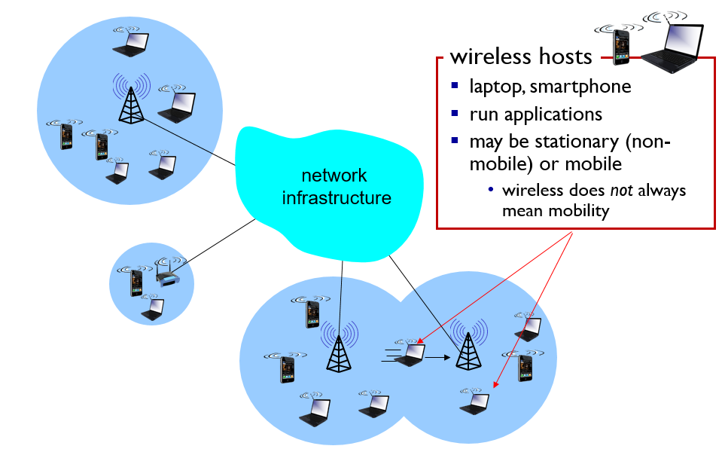
Elements of a Wireless Network (1 of 5)

Slide 5
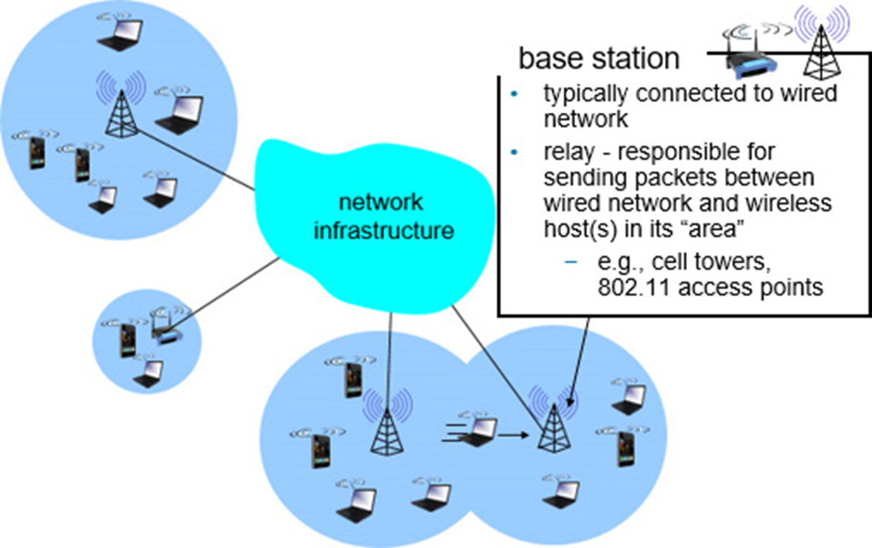
Elements of a Wireless Network (2 of 5)

Slide 6
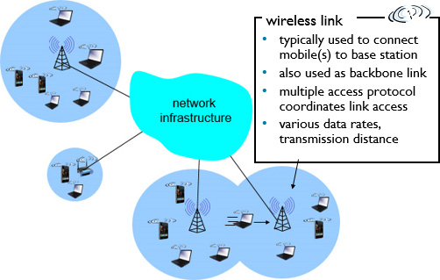
Elements of a Wireless Network (3 of 5)

Slide 7
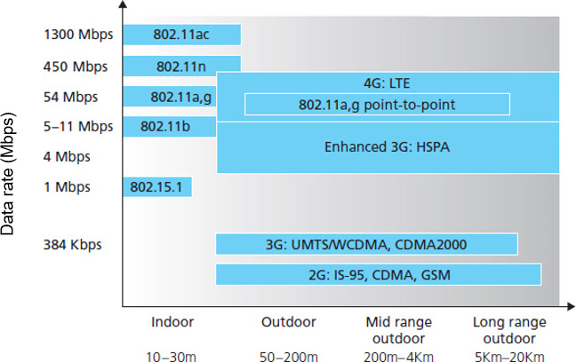
Characteristics of Selected Wireless Links

Slide 8
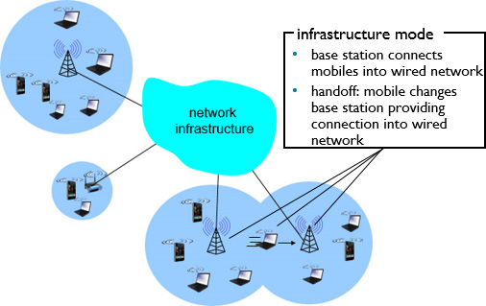
Elements of a Wireless Network (4 of 5)

Slide 9
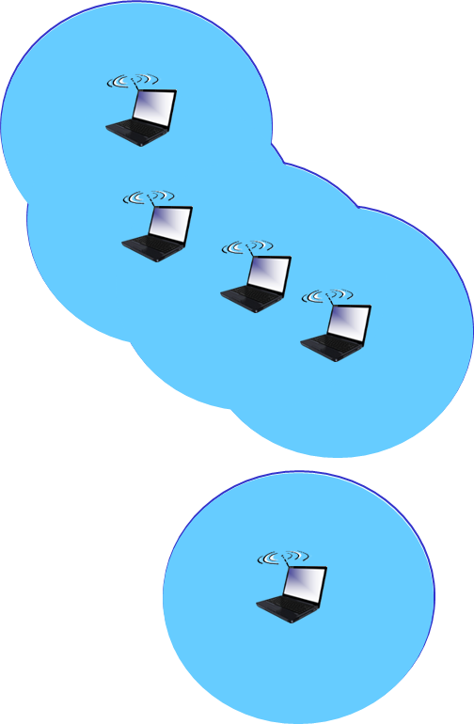
Elements of a Wireless Network (5 of 5)
ad hoc mode
No base stations
Nodes can only transmit to other nodes within link coverage
Nodes organize themselves into a network: route among themselves

Slide 10
Wireless Network Taxonomy
Blank | Single hop | Multiple hops
Infrastructure (e.g.,APs) | Host connects to base station (WiFi, WiMAX, cellular) which connects to larger Internet | Host may have to relay through several wireless nodes to connect to larger Internet: mesh net
No infrastructure | No base station, no connection to larger Internet (Bluetooth, ad hoc nets) | No base station, no connection to larger Internet. May have to relay to reach other a given wireless node M A N E T, V A N E T

Slide 11
Learning Objectives (2 of 6)
7.1 Introduction
Wireless
7.2 Wireless links, characteristics
C D M A
7.3 I E E E 802.11 wireless LANs (“Wi-Fi”)
7.4 Cellular Internet Access
architecture
standards (e.g., 3G, L T E)
Mobility
7.5 Principles: addressing and routing to mobile users
7.6 Mobile I P
7.7 Handling mobility in cellular networks
7.8 Mobility and higher-layer protocols

Slide 12
Wireless Link Characteristics (1 of 2)
Important differences from wired link ….
Decreased signal strength: radio signal attenuates as it propagates through matter (path loss)
Interference from other sources: standardized wireless network frequencies (e.g., 2.4 GigaHertz) shared by other devices (e.g., phone); devices (motors) interfere as well
Multipath propagation: radio signal reflects off objects ground, arriving ad destination at slightly different times
…. make communication across (even a point to point) wireless link much more “difficult”

Slide 13
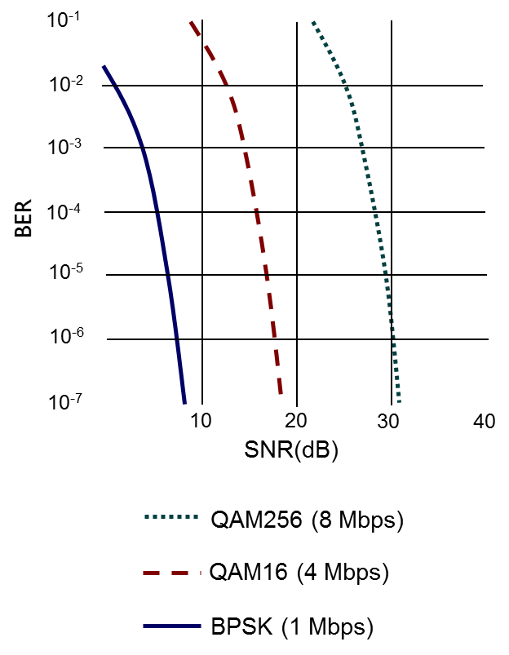
Wireless Link Characteristics (2 of 2)
S N R: signal-to-noise ratio
Larger S N R – easier to extract signal from noise (a “good thing”)
S N R versus B E R tradeoffs
given physical layer: increase power -> increase S N R ->decrease B E R
given S N R: choose physical layer that meets B E R requirement, giving highest thruput
S N R may change with mobility: dynamically adapt physical layer (modulation technique, rate)

Slide 14
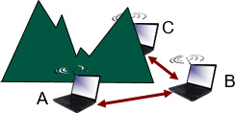
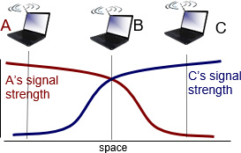
Wireless Network Characteristics (1 of 2)
Multiple wireless senders and receivers create additional problems (beyond multiple access):

Slide 15
Wireless Network Characteristics (2 of 2)
Hidden terminal problem
B, A hear each other
B, C hear each other
A, C can not hear each other means A, C unaware of their interference at B
Signal attenuation:
B, A hear each other
B, C hear each other
A, C can not hear each other interfering at B

Slide 16
Code Division Multiple Access (C D M A)
Unique “code” assigned to each user; i.e., code set partitioning
all users share same frequency, but each user has own “chipping” sequence (i.e., code) to encode data
allows multiple users to “coexist” and transmit simultaneously with minimal interference (if codes are “orthogonal”)
Encoded signal = (original data) X (chipping sequence)
Decoding: inner-product of encoded signal and chipping sequence

Slide 17
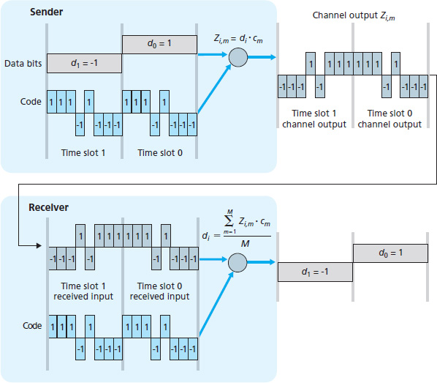
C D M A Encode/Decode

Slide 18
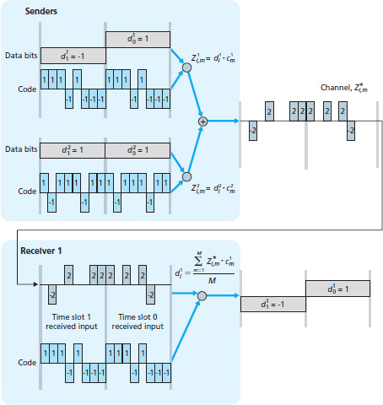
C D M A: Two-Sender Interference

Slide 19
Learning Objectives (3 of 6)
7.1 Introduction
Wireless
7.2 Wireless links, characteristics
C D M A
7.3 I E E E 802.11 wireless LANs (“Wi-Fi”)
7.4 Cellular Internet Access
architecture
standards (e.g., 3G, L T E)
Mobility
7.5 Principles: addressing and routing to mobile users
7.6 Mobile I P
7.7 Handling mobility in cellular networks
7.8 Mobility and higher-layer protocols

Slide 20
I E E E 802.11 Wireless L A N
802.11b
2.4-5 GigaHertz unlicensed spectrum
up to 11 M b p s
direct sequence spread spectrum (D S S S) in physical layer
all hosts use same chipping code
802.11g
2.4-5 GigaHertz range
up to 54 M b p s
802.11n: multiple antennae
2.4-5 GigaHertz range
up to 200 M b ps
802.11a
5-6 GigaHertz range
up to 54 M b ps
all use C S M A/C A for multiple access
all have base-station and ad-hoc network versions

Slide 21
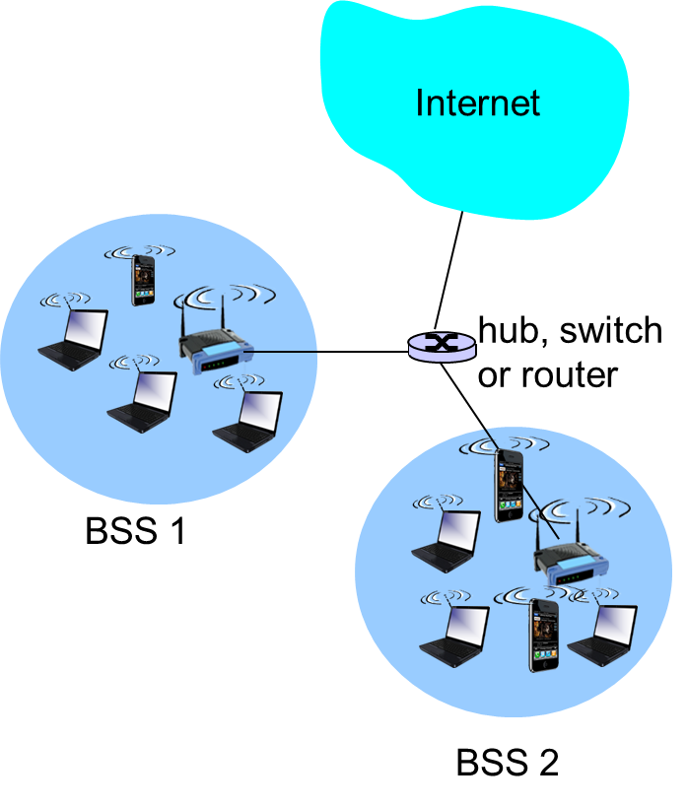
802.11 LAN Architecture
Wireless host communicates with base station
base station = access point (A P)
Basic Service Set (B S S) (aka “cell”) in infrastructure mode contains:
wireless hosts
access point (A P): base station
ad hoc mode: hosts only

Slide 22
802.11: Channels, Association
802.11b: 2.4GigaHertz-2.485GigaHertz spectrum divided into 11 channels at different frequencies
A P admin chooses frequency for A P
Interference possible: channel can be same as that chosen by neighboring A P!
Host: must associate with an A P
scans channels, listening for beacon frames containing A P’s name (S S I D) and M A C address
selects A P to associate with
may perform authentication [Chapter 8]
will typically run D H C P to get I P address in A P’s subnet

Slide 23
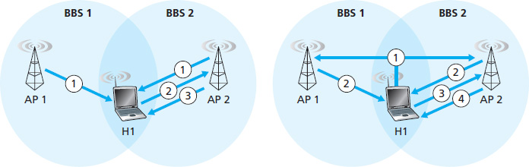
802.11: Passive/Active Scanning (1 of 2)

Slide 24
802.11: Passive/Active Scanning (2 of 2)
Passive scanning:
(1) beacon frames sent from A Ps
(2) association Request frame sent: H1 to selected A P
(3) association Response frame sent from selected A P to H1
Active scanning:
(1) Probe Request frame broadcast from H1
(2) Probe Response frames sent from A Ps
(3) Association Request frame sent: H1 to selected A P
(4) Association Response frame sent from selected A P to H1

Slide 25
I E E E 802.11: Multiple Access
avoid collisions:
nodes transmitting at same time
802.11: C S M A - sense before transmitting
Don’t collide with ongoing transmission by other node
802.11: no collision detection!
Difficult to receive (sense collisions) when transmitting due to weak received signals (fading)
Can’t sense all collisions in any case: hidden terminal, fading
Goal: avoid collisions: C S M A/C(ollision)A(voidance)

Slide 26
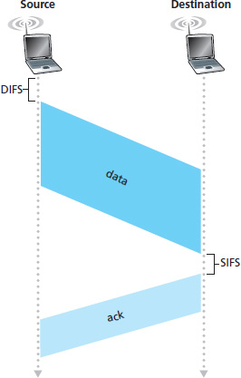
I E E E 802.11 M A C Protocol: C S M A /C A
802.11 sender
If sense channel idle for D I F S then transmit entire frame (no C D)
If sense channel busy then start random backoff time timer counts down while channel idle transmit when timer expires if no A C K, increase random backoff interval, repeat 2
802.11 receiver
If frame received OK return A C K after S I F S (A C K needed due to hidden terminal problem)

Slide 27
Avoiding collisions
Idea: Allow sender to “reserve” channel rather than random access of data frames: avoid collisions of long data frames
Sender first transmits small request-to-send (R T S) packets to B S using C S M A
R T Ss may still collide with each other (but they’re short)
B S broadcasts clear-to-send C T S in response to R T S
C T S heard by all nodes
sender transmits data frame
other stations defer transmissions
Avoid data frame collisions completely using small reservation packets!

Slide 28
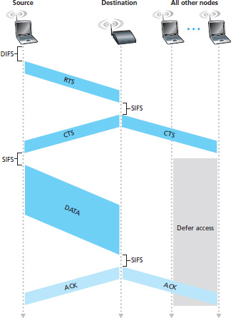
Collision Avoidance: R T S-C T S exchange

Slide 29
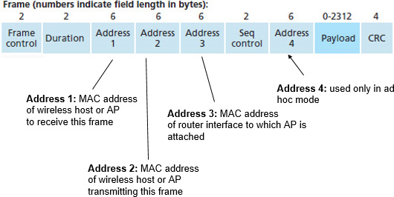
802.11 Frame: Addressing (1 of 2)

Slide 30
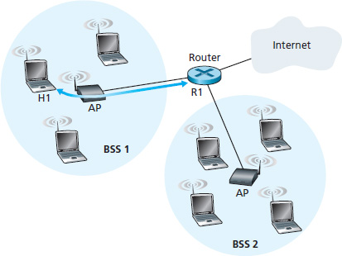
802.11 Frame: Addressing (2 of 2)

Slide 31
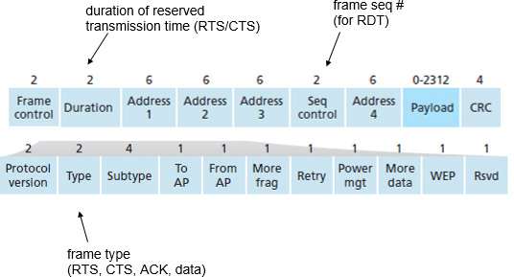
802.11 Frame: More

Slide 32
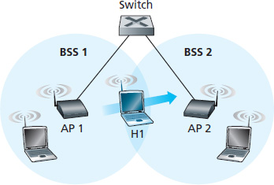
802.11: Mobility within Same Subnet
H1 remains in same I P subnet: I P address can remain same
Switch: which A P is associated with H1?
Self-learning (Ch. 5): switch will see frame from H1 and “remember” which switch port can be used to reach H1

Slide 33
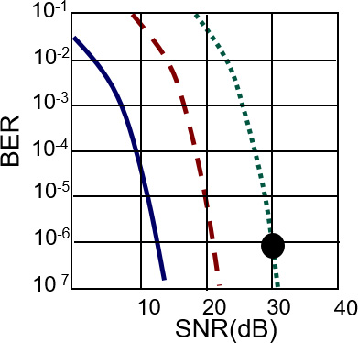
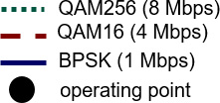
802.11: Advanced Capabilities (1 of 2)
Rate adaptation
Base station, mobile dynamically change transmission rate (physical layer modulation technique) as mobile moves, S N R varies
S N R decreases, B E R increase as node moves away from base station
When B E R becomes too high, switch to lower transmission rate but with lower B E R

Slide 34
802.11: Advanced Capabilities (2 of 2)
Power management
node-to-A P: “I am going to sleep until next beacon frame”
A P knows not to transmit frames to this node
node wakes up before next beacon frame
Beacon frame: contains list of mobiles with A P-to-mobile frames waiting to be sent
Node will stay awake if A P-to-mobile frames to be sent; otherwise sleep again until next beacon frame

Slide 35
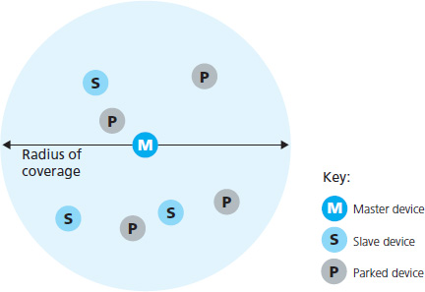
802.15: Personal Area Network
Less than 10 meter diameter
Replacement for cables (mouse, keyboard, headphones)
ad hoc: no infrastructure
Master/Slaves:
Slaves request permission to send (to master)
Master grants requests
802.15: Evolved from Bluetooth specification
2.4-2.5 GigaHertz radio band
up to 721 k b p s

Slide 36
Learning Objectives (4 of 6)
7.1 Introduction
Wireless
7.2 Wireless links, characteristics
C D M A
7.3 I E E E 802.11 wireless LANs (“Wi-Fi”)
7.4 Cellular Internet Access
architecture
standards (e.g., 3G, L T E)
Mobility
7.5 Principles: addressing and routing to mobile users
7.6 Mobile I P
7.7 Handling mobility in cellular networks
7.8 Mobility and higher-layer protocols

Slide 37
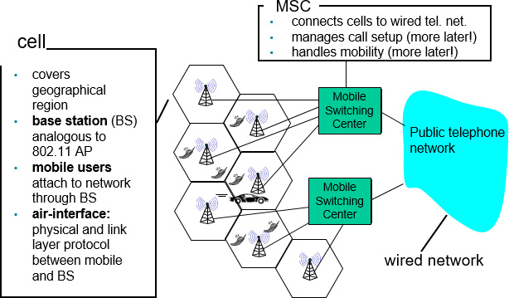
Components of Cellular Network Architecture (1 of 2)

Slide 38
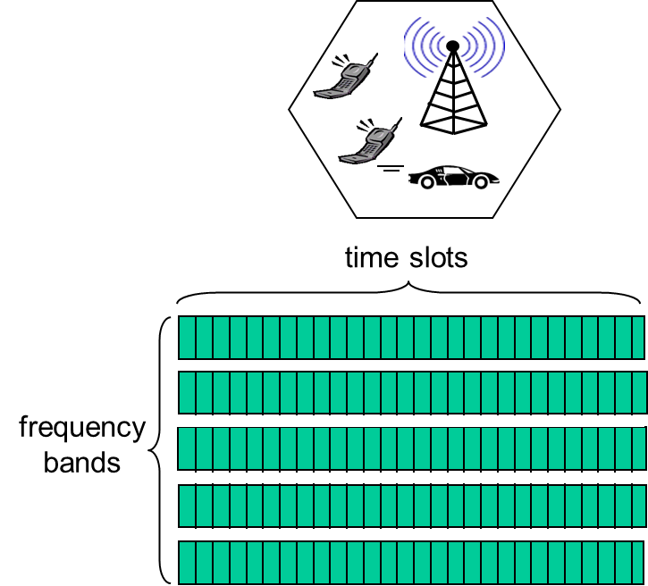
Cellular Networks: The First Hop
Two techniques for sharing mobile-to-B S radio spectrum
Combined F D M A/T D M A: divide spectrum in frequency channels, divide each channel into time slots
C D M A: code division multiple access

Slide 39
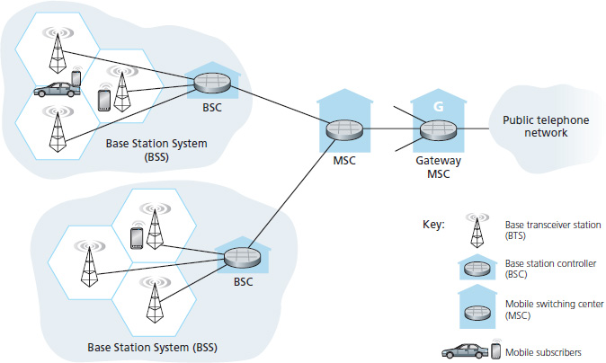
2G (voice) Network Architecture

Slide 40
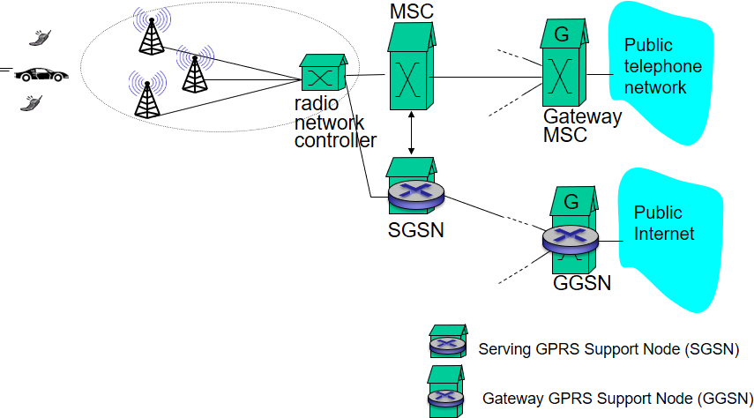
3G (voice+data) Network Architecture (1 of 2)
Key insight: new cellular data network operates in parallel (except at edge) with existing cellular voice network
voice network unchanged in core
data network operates in parallel

Slide 41
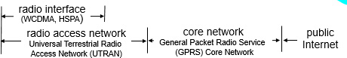
3G (voice+data) Network Architecture (2 of 2)

Slide 42
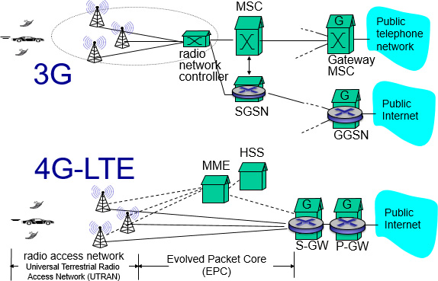
3G versus 4G L T E Network Architecture

Slide 43
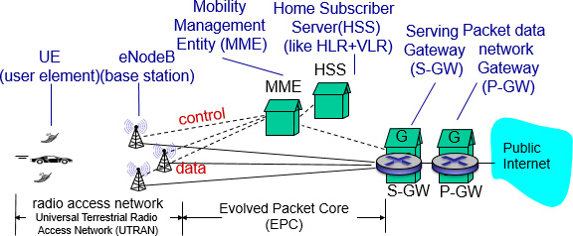
4G: Differences from 3G
all I P core: I P packets tunneled (through core I P network) from base station to gateway
no separation between voice and data – all traffic carried over I P core to gateway

Slide 44
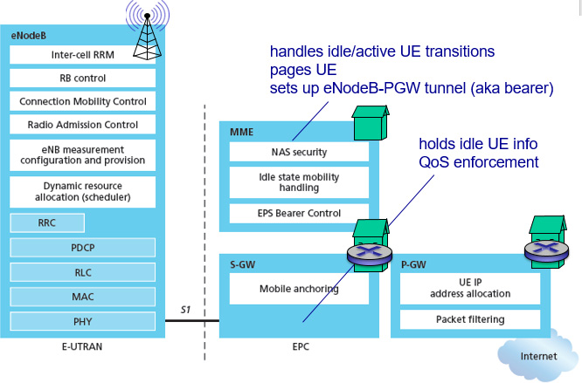
Functional Split of Major L T E Components

Slide 45
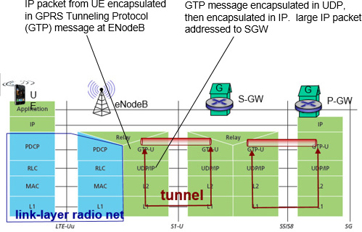
Radio+Tunneling: U E – eNodeB – P G W

Slide 46
Quality of Service in L T E
Q o S from eNodeB to S G W: min and max guaranteed bit rate
Q o S in radio access network: one of 12 Q C I values
Q C I | Resource type | Priority | Packet delay Budget (ms) | Packet error loss rate | Example services
1 | G B R | 2 | 100 | 10 to the negative second power | Conversational voice
2 | G B R | 4 | 150 | 10 to the negative third power | Conversational video (live streaming)
3 | G B R | 5 | 300 | 10 to the negative six power | Non-conversational video (buffer streaming)
4 | G B R | 3 | 50 | 10 to the negative third power | Real-time gaming
5 | Non-G B R | 1 | 100 | 10 to the negative six power | I M S signaling
6 | Non-G B R | 7 | 100 |  | Voice ,video (live streaming),interactive gaming
7 | Non-G B R | 6 | 300 | 10 to the negative six power | Video (buffer streaming)
8 | Non-G B R | 8 | 300 | 10 to the negative six power | TCP-based (for example,WWW,e-mail),chat,FTP,p2p file sharing,Progressive video and others
9 | Non-G B R | 9 | 300 | 10 to the negative six power

Slide 47
Learning Objectives (5 of 6)
7.1 Introduction
Wireless
7.2 Wireless links, characteristics
C D M A
7.3 I E E E 802.11 wireless LANs (“Wi-Fi”)
7.4 Cellular Internet Access
architecture
standards (e.g., 3G, L T E)
Mobility
7.5 Principles: addressing and routing to mobile users
7.6 Mobile I P
7.7 Handling mobility in cellular networks
7.8 Mobility and higher-layer protocols

Slide 48
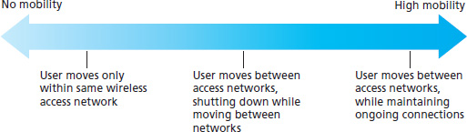
What is Mobility?
spectrum of mobility, from the network perspective:

Slide 49
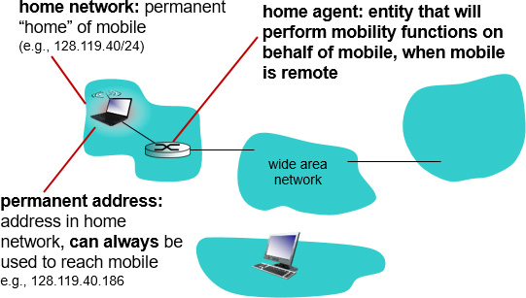
Mobility: Vocabulary

Slide 50
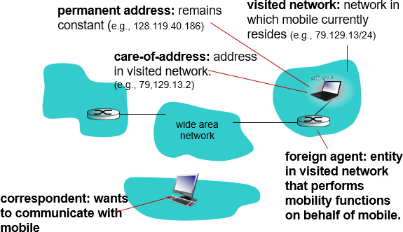
Mobility: More Vocabulary

Slide 51

How Do You Contact a Mobile Friend
Consider friend frequently changing addresses, how do you find her?
Search all phone books?
Call her parents?
Expect her to let you know where he/she is?
Facebook!

Slide 52
Mobility: Approaches (1 of 2)
let routing handle it: routers advertise permanent address of mobile-nodes-in-residence via usual routing table exchange.
routing tables indicate where each mobile located
no changes to end-systems
let end-systems handle it:
Indirect routing: communication from correspondent to mobile goes through home agent, then forwarded to remote
Direct routing: correspondent gets foreign address of mobile, sends directly to mobile

Slide 53
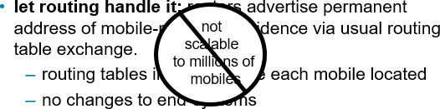
Mobility: Approaches (2 of 2)
let end-systems handle it:
Indirect routing: communication from correspondent to mobile goes through home agent, then forwarded to remote
Direct routing: correspondent gets foreign address of mobile, sends directly to mobile

Slide 54
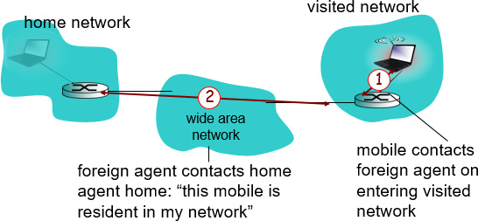
Mobility: Registration
End result:
Foreign agent knows about mobile
Home agent knows location of mobile

Slide 55
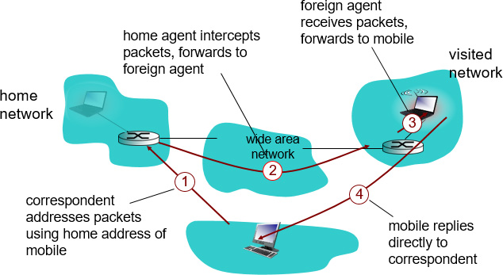
Mobility via Indirect Routing

Slide 56
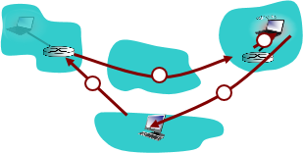
Indirect Routing: Comments
Mobile uses two addresses:
Permanent address: used by correspondent (hence mobile location is transparent to correspondent)
Care-of-address: used by home agent to forward datagrams to mobile
Foreign agent functions may be done by mobile itself
Triangle routing: correspondent-home-network-mobile
inefficient when correspondent, mobile are in same network

Slide 57
Indirect Routing: Moving Between Networks
Suppose mobile user moves to another network
registers with new foreign agent
new foreign agent registers with home agent
home agent update care-of-address for mobile
packets continue to be forwarded to mobile (but with new care-of-address)
Mobility, changing foreign networks transparent: on going connections can be maintained!

Slide 58
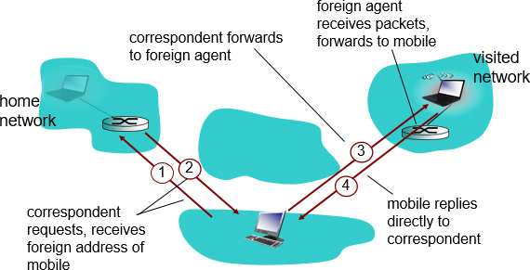
Mobility via Direct Routing

Slide 59
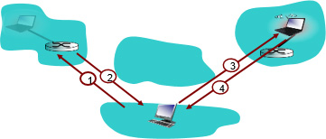
Mobility via Direct Routing: Comments
overcome triangle routing problem
non-transparent to correspondent: correspondent must get care-of-address from home agent
what if mobile changes visited network?

Slide 60
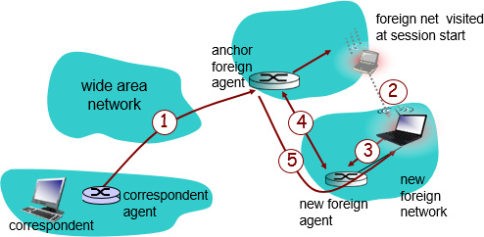
Accommodating Mobility with Direct Routing
Anchor foreign agent: F A in first visited network
Data always routed first to anchor F A
When mobile moves: new F A arranges to have data forwarded from old F A (chaining)

Slide 61
Learning Objectives (6 of 6)
7.1 Introduction
Wireless
7.2 Wireless links, characteristics
C D M A
7.3 I E E E 802.11 wireless LANs (“Wi-Fi”)
7.4 Cellular Internet Access
architecture
standards (e.g., 3G, L T E)
Mobility
7.5 Principles: addressing and routing to mobile users
7.6 Mobile I P
7.7 Handling mobility in cellular networks
7.8 Mobility and higher-layer protocols

Slide 62
Mobile I P
R F C 3344
Has many features we’ve seen:
home agents, foreign agents, foreign-agent registration, care-of-addresses, encapsulation (packet-within-a-packet)
Three components to standard:
indirect routing of datagrams
agent discovery
registration with home agent

Slide 63
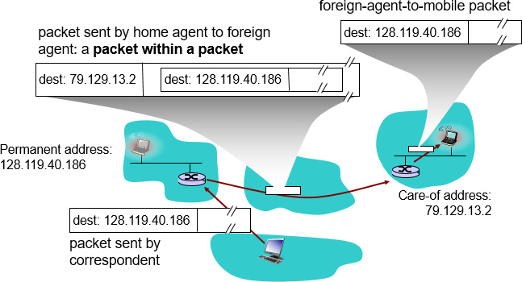
Mobile I P: Indirect routing

Slide 64
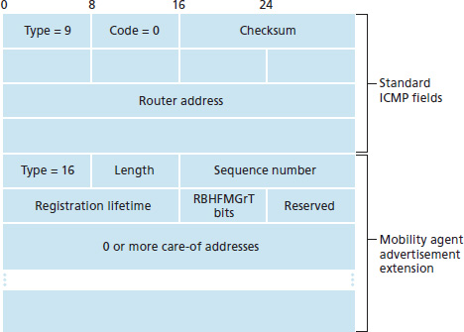
Mobile I P: Agent discovery
Agent Advertisement: Foreign/Home agents advertise service by broadcasting I C M P messages (typefield = 9)

Slide 65
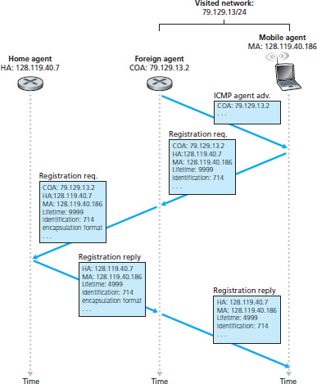
Mobile I P: Registration Example

Slide 66
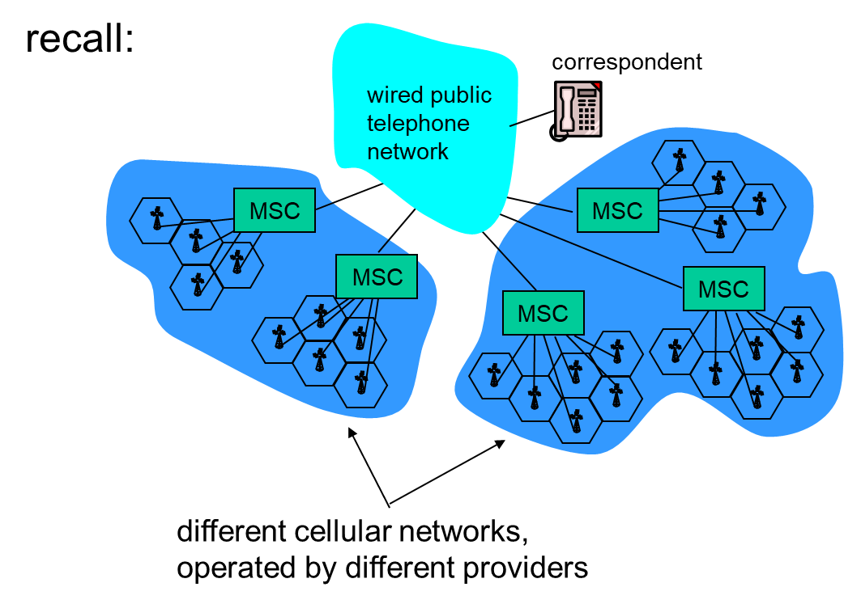
Components of Cellular Network Architecture (2 of 2)

Slide 67
Handling Mobility in Cellular networks
Home Network: network of cellular provider you subscribe to (e.g., Sprint P C S, Verizon)
Home location register (H L R): database in home network containing permanent cell phone #, profile information (services, preferences, billing), information about current location (could be in another network)
Visited Network: network in which mobile currently resides
Visitor location register (V L R): database with entry for each user currently in network
could be home network

Slide 68
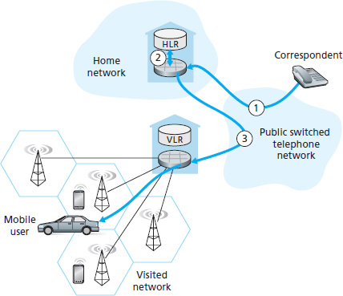
G S M: Indirect Routing to Mobile

Slide 69
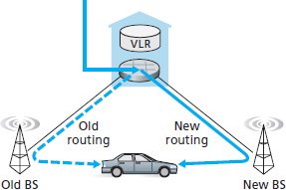
G S M: Handoff with Common M S C (1 of 2)
Handoff goal: route call via new base station (without interruption)
Reasons for handoff:
stronger signal to/from new B S S (continuing connectivity, less battery drain)
load balance: free up channel in current B S S
G S M doesn’t mandate why to perform handoff (policy), only how (mechanism)
Handoff initiated by old B S S

Slide 70
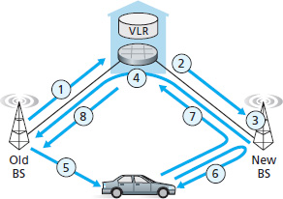
G S M: Handoff with Common M S C (2 of 2)
Old B S S informs M S C of impending handoff, provides list of
new B S Ss
MSC sets up path (allocates resources) to new B S S
New B S S allocates radio channel for use by mobile
New B S S signals M S C, old B S S: ready
Old B S S tells mobile: perform handoff to new B S S
Mobile, new B S S signal to activate new channel
Mobile signals via new B S S to M S C : handoff complete.
M S C reroutes call resources released

Slide 71
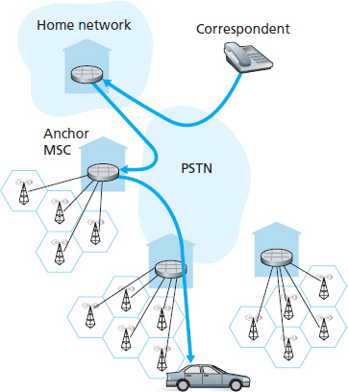
G S M: Handoff Between M S Cs (1 of 2)
Anchor M S.C: first M S.C visited during call
call remains routed through anchor M S.C
new M S.Cs add on to end of M S.C chain as mobile moves to new M S.C
optional path minimization step to shorten multi-M S.C chain

Slide 72

G S M: Handoff Between M S Cs (2 of 2)
Anchor M S.C: first M S.C visited during call
call remains routed through anchor M S.C
new M S.Cs add on to end of M S.C chain as mobile moves to new M S.C
optional path minimization step to shorten multi-M S.C chain

Slide 73

Handling Mobility in L T E
Paging: idle U E may move from cell to cell: network does not know where the idle U E is resident
paging message from M M E broadcast by all eNodeB to locate U E
Handoff: similar to 3G:
preparation phase
execution phase
completion phase

Slide 74
Mobility: Cellular Versus Mobile I P
Cellular element | Comment on cellular element | Mobile IP element
Home system | Network to which mobile user’s permanent phone number belongs | Home network
Gateway Mobile Switching Center, or “home M S C”. Home Location Register (H L R) | Home M S C: point of contact to obtain routable address of mobile user. H L R: database in home system containing permanent phone number, profile information, current location of mobile user, subscription information | Home agent
Visited System | Network other than home system where mobile user is currently residing | Visited network
Visited Mobile services Switching Center. Visitor Location Record (V L R) | Visited M S C: responsible for setting up calls to/from mobile nodes in cells associated with M S C. V L R: temporary database entry in visited system, containing subscription information for each visiting mobile user | Foreign agent
Mobile Station Roaming Number (M S R N), or “roaming number” | Routable address for telephone call segment between home M S C and visited M S C, visible to neither the mobile nor the correspondent. | Care-of-address

Slide 75
Wireless, Mobility: Impact on Higher Layer Protocols
Logically, impact should be minimal …
best effort service model remains unchanged
T C P and U D P can (and do) run over wireless, mobile
… but performance-wise:
packet loss/delay due to bit-errors (discarded packets, delays for link-layer retransmissions), and handoff
T C P interprets loss as congestion, will decrease congestion window un-necessarily
delay impairments for real-time traffic
limited bandwidth of wireless links

Slide 76
Chapter summary (1 of 2)
Wireless
wireless links:
capacity, distance
channel impairments
C D M A
I E E E 802.11 (“Wi-Fi”)
C S M A/C A reflects wireless channel characteristics
cellular access
architecture
standards (e.g., 3G, 4G L T E)

Slide 77
Chapter summary (2 of 2)
Mobility
principles: addressing, routing to mobile users
home, visited networks
direct, indirect routing
care-of-addresses
case studies
mobile I P
mobility in G S M, L T E
impact on higher-layer protocols

Slide 78

Copyright

